Slide 1
Development and Design of Cultural Heritage Site Management System.
2025/07/04
Presenter:Yao, Jiang,Yang,Yin,Zhao

Slide 2


Define data structure
This project is a system designed for the management and protection of cultural heritage sites. It focuses on efficiently organizing cultural relics, structures within the site, and managing visitor tours. The system uses a tree structure to hierarchically organize cultural relics and a queue structure to manage the visitor flow.

Slide 3
01
Cultural Heritage Organization
02
Tourist Experience Management
CONTENTS
03
Advanced functions
04
Additional functions

Slide 4
Cultural Heritage Organization
01

Slide 5
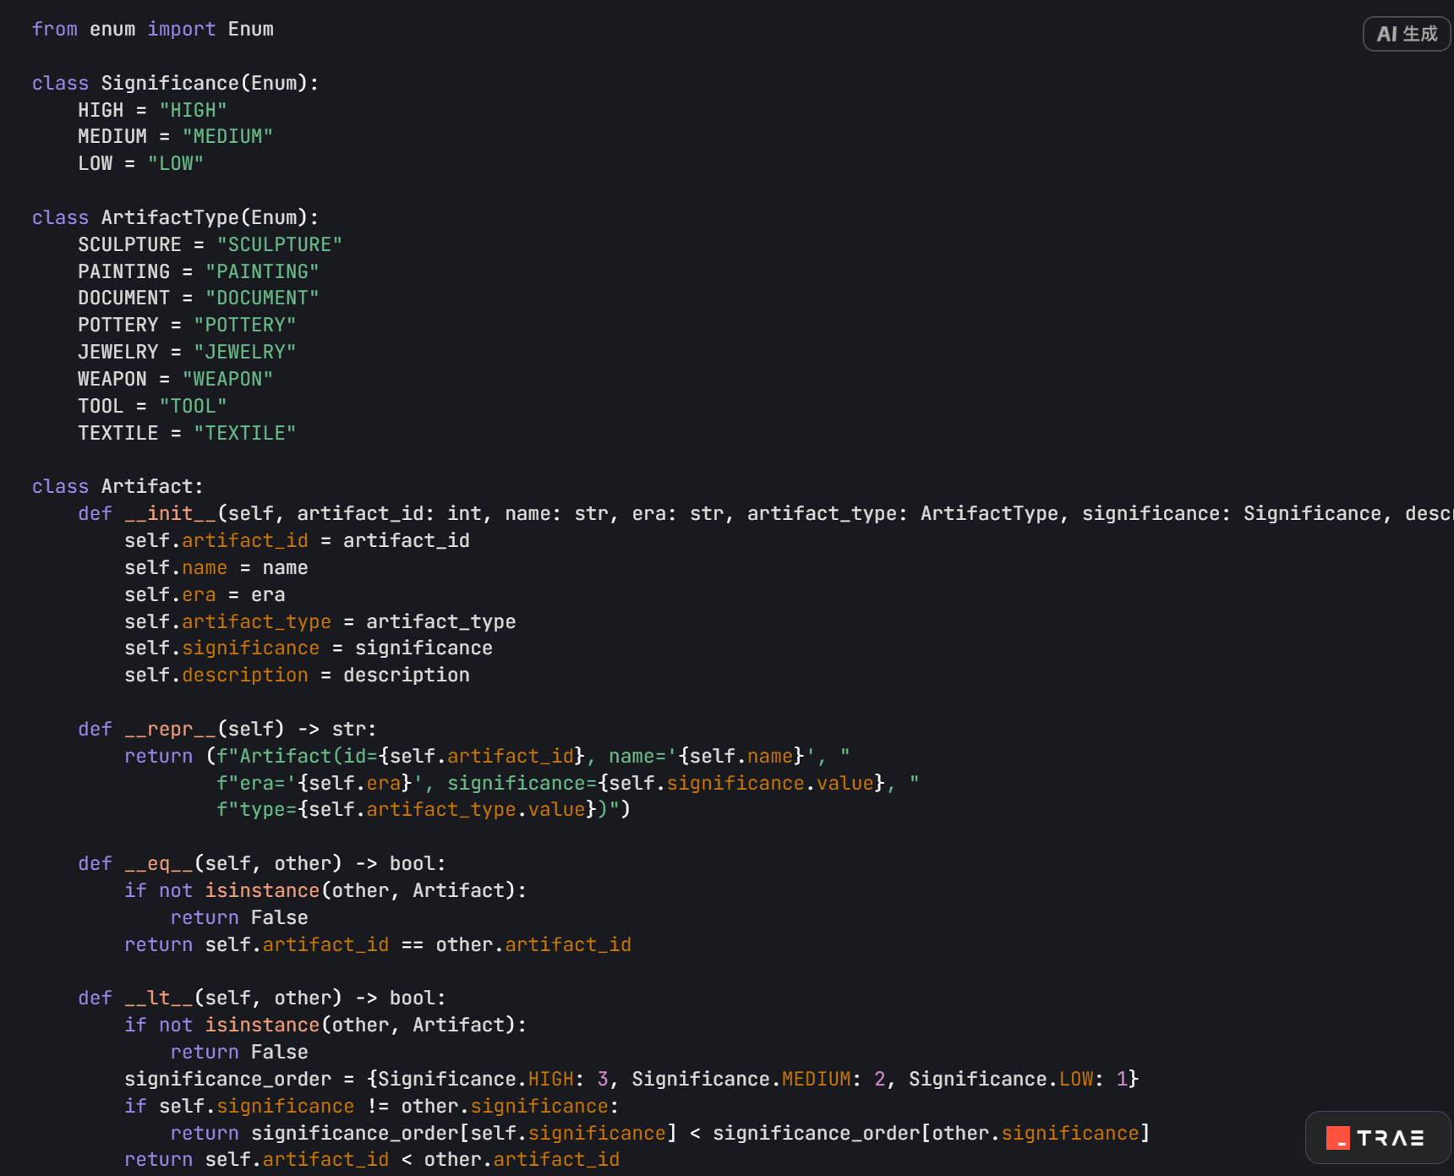
Define data structure
The "Cultural Relics Tree" represents:- Design a Python class for each cultural relic in the site.
Node Information: Include the relic's number, name, era it belongs to, -significance, and type-
Enumerated Types: Define possible values for significance and type.
Practical Methods: Implement string representation, comparison, and other operations

Slide 6
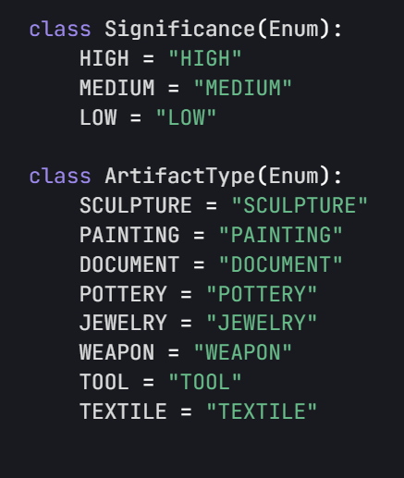
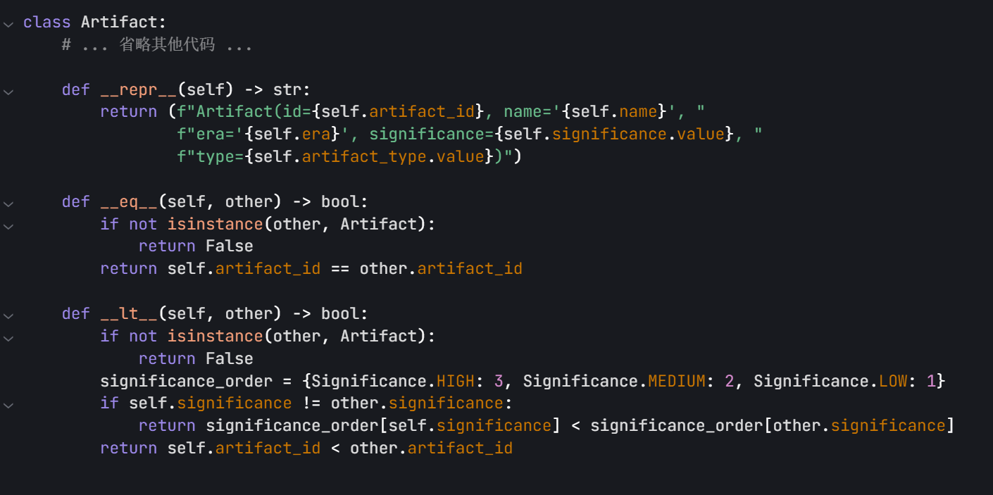
Significance and ArtifactType are enumeration types that define the possible values for the significance and type of artifacts, ensuring data consistency and type safety. The Artifact class represents an artifact and contains information such as the artifact's ID, name, era, significance, type, and description. The repr_ method provides a string representation of the artifact for easy debugging and viewing.
The __eq__ method is used to compare whether two artifacts are equal, based on the artifact ID. The __lt__ method is used to compare the size of two artifacts, first sorting by significance, and if the significance is the same, then by the artifact ID.
The `significance` enumeration defines the importance levels of artifacts, including high, medium, and low. The `ArtifactType` enumeration defines the types of artifacts, such as sculptures, paintings, documents, etc.

Slide 7
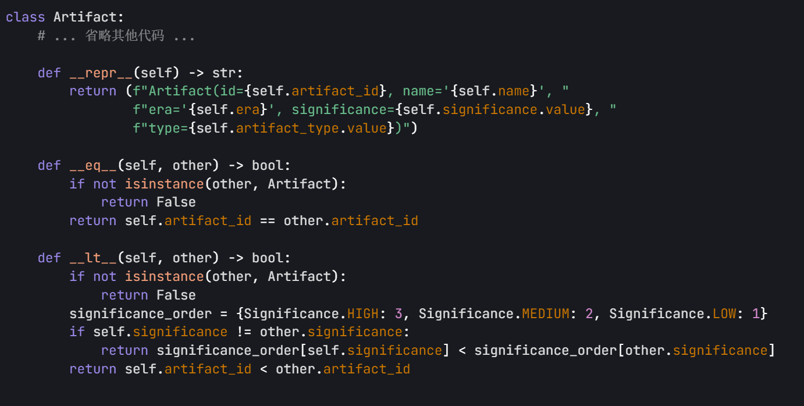
The repr_ method returns the string representation of the artifact, facilitating the viewing of artifact information during debugging and logging. The eq_ method is used to compare whether two artifacts are equal, by comparing the artifact numbers. The 1t_ method is used to compare the sizes of two artifacts. It first compares the importance, and if the importance is the same, it compares the artifact numbers.

Slide 8
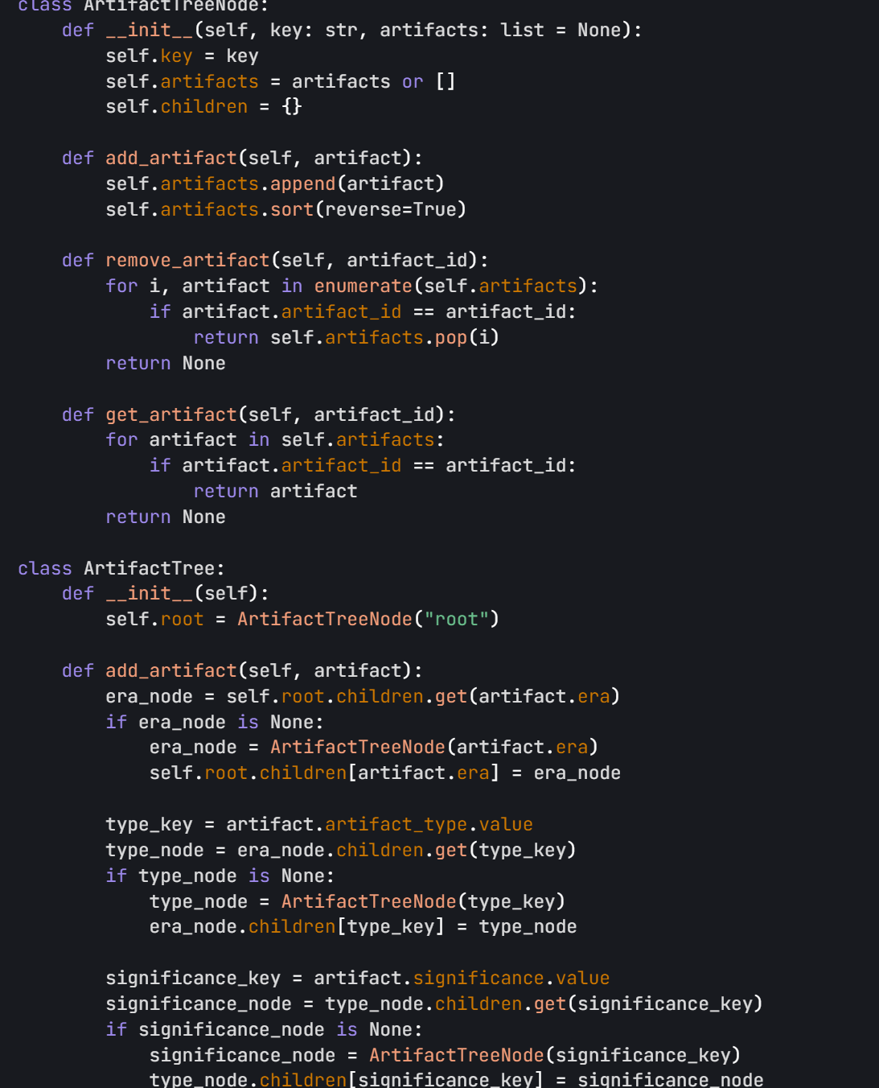
Significance and ArtifactType are both enumeration types, which define the possible values for the importance and type of cultural relics respectively, ensuring data consistency and type safety. The Artifact class represents cultural relics and contains information such as relic number, name, era, importance, type, and description. The repr_ method provides a string representation of the relic, facilitating debugging and viewing. The eq_ method is used to compare whether two relics are equal, based on the relic number. The 1t_ method is used to compare the sizes of two relics, first sorting by importance, and if the importance is the same, sorting by relic number.

Slide 9
Tourist Experience Management
02

Slide 10
Queue structure representation - Overall concept
客游客组管理：设计一个 Python 类来管理游客Design a Python class to manage the tourist tour queue and achieve efficient management of tourist groups.
Node information:
Each node represents a tourist group, containing the tourist group number, arrival time, and reservation priority.
Priority queue:
The order of tourist groups is determined based on arrival time and reservation priority to ensure that high-priority and first-arriving tourist groups are given priority for service.

Slide 11

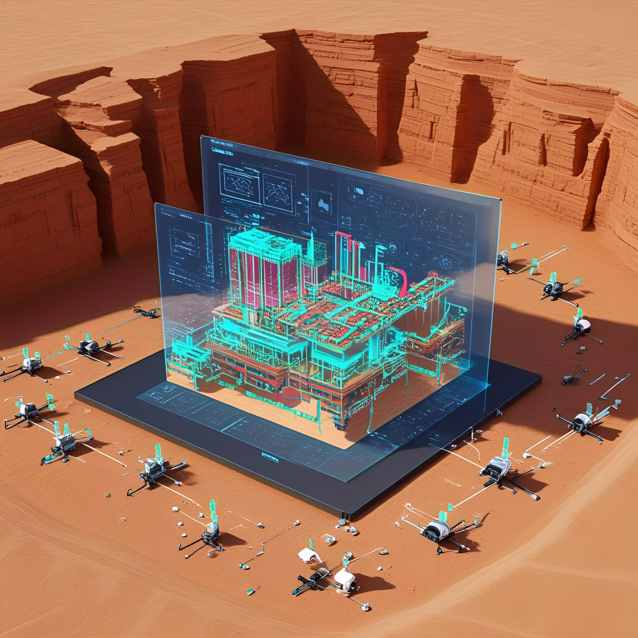



Distribution
1. Definition of related classes
2. Queue utility function - Add tourist group
3. Queue utility function -
Remove tourist group
4. Queue utility function -
View the next tourist group

Slide 12
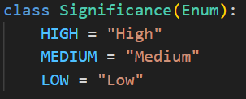
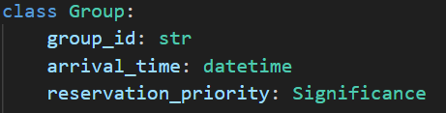
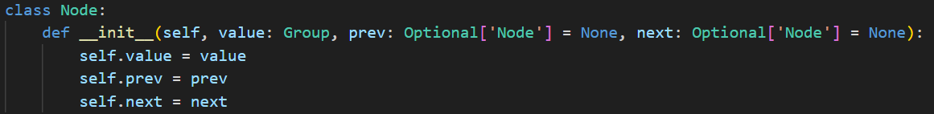
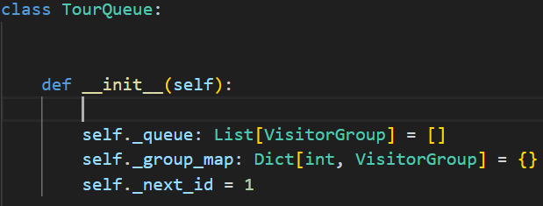
Related class definition
The Significance enumeration defines the importance level of the tourist group.
The Group data class encapsulates the basic information of the tourist group, including the group number, arrival time, and reservation priority.
The Node class is used to construct a doubly linked list, and each node contains a tourist group object.
The TourQueue class is the core class, which uses a priority queue to manage the tourist groups and provides a fast search function.

Slide 13
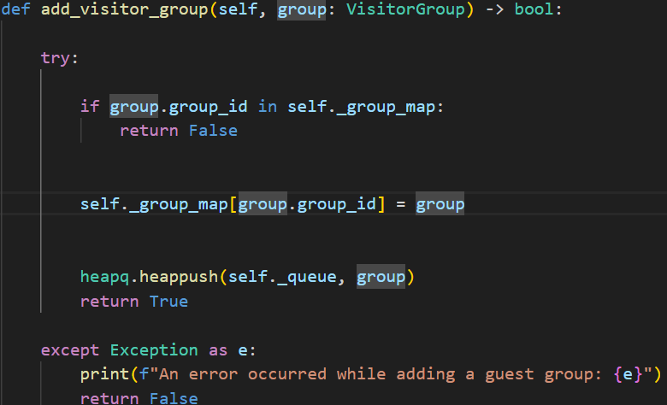
Add tourist group
First, check if the tourist group ID already exists in the mapping table. If it does, return False.
Add the tourist group to the mapping table for quick lookup.
Use heapq.heappush to add the tourist group to the priority queue to ensure it is sorted by priority.
If an exception occurs, print the error message and return False.

Slide 14
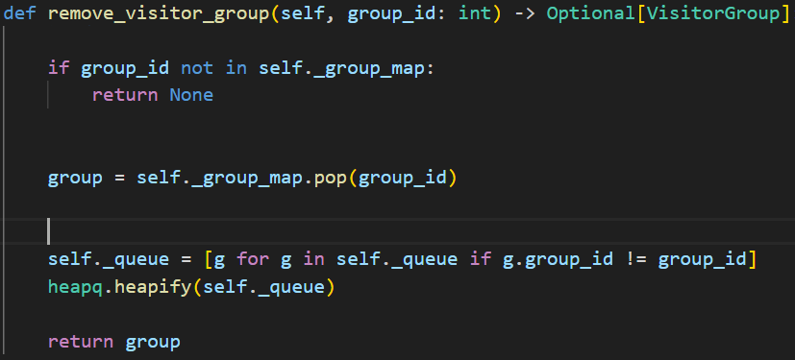
Remove the tourist group
Code explanation
Code example
1. First, check if the visitor group ID exists in the mapping table. If not, return None.
2. Remove the visitor group from the mapping table.
3. Rebuild the queue, remove the visitor group with the specified ID, and reheap the queue.
4. Return the removed visitor group.

Slide 15
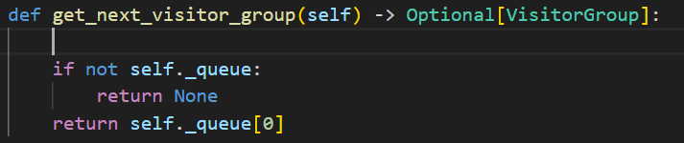
View the next group of tourists
1. Check if the queue is empty. If it is empty, return None.
2. If the queue is not empty, return the first element of the queue, which is the next tourist group.

Slide 16
Summary
功能回顾：介绍了游客导览队列的结构和管理方法。
Function Review:
It introduces the structure and management methods of the tourist guide queue.
It demonstrates the implementation and functions of the queue tools, including adding, removing, viewing, and re-arranging tourist groups.
Advantages and Applications:
It enhances the efficiency and accuracy of tourist experience management.
It ensures that high-priority and first-arriving tourist groups receive services first.
Future Outlook:
It further optimizes the queue algorithm to improve performance.
It integrates with other modules to achieve a more comprehensive tourist experience management.

Slide 17
Advanced features
03

Slide 18
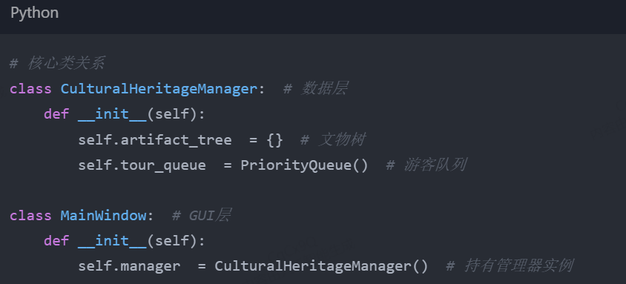
SystemArchitecture Diagram
Architectural level division
Core class relationship
The system adopts a three-layer architecture. The GUI layer is responsible for user interaction, the logic layer contains the scheduling algorithm, and the data layer manages the cultural heritage tree and the tourist queue. The core modules are associated through class instances, for example, `MainWindow` holds an instance of `CulturalHeritageManager`, enabling functional coordination.
The `CulturalHeritageManager` class in the data layer manages the cultural heritage tree and the visitor queue. The `MainWindow` class in the GUI layer holds the instance of the manager and implements the interaction between data and the interface, ensuring the efficient operation of the system functions. Code example:

Slide 19




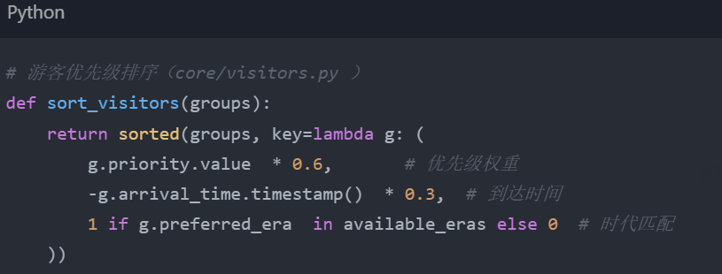
Preference Navigation Algorithm
Weight distribution mechanism
Actual application scenarios
The navigation algorithm is based on multi-dimensional weight allocation, such as giving priority to VIP tourists and matching with era preferences, etc. The weight ratio is 60%/30%/10%. The weight allocation is displayed through a bar chart, and the sorting process animation shows the transition from the original queue to weighted calculation and finally to the final sorting, presenting the logic of tourist priority ranking intuitively. Code example: ```
In practical applications, VIP tourists are given higher priority. The system will conduct a comprehensive ranking based on the arrival time and personal preferences of the tourists, ensuring that they can enjoy a more personalized guided tour experience and enhancing the satisfaction of the visit.

Slide 20
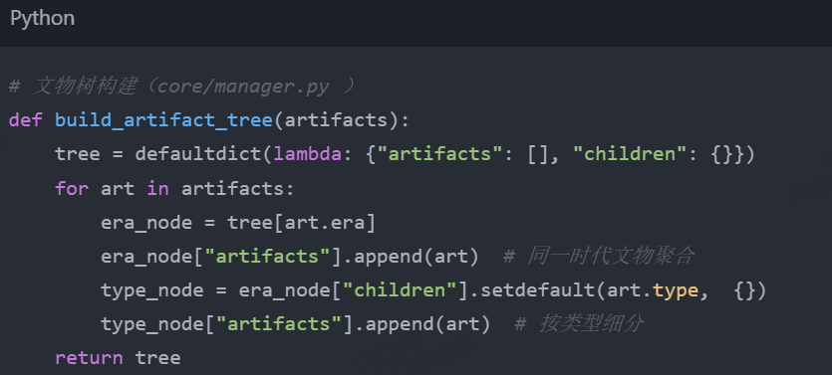
Archaeological Tree Data Structure
The cultural relic tree adopts a dual-index structure. The hash index enables O(1) fast retrieval, while the tree index supports O(log n) classification statistics. The construction code divides cultural relics by era and type. The comparison diagram of the hash table and the tree structure clearly demonstrates its advantages, thereby improving the efficiency of cultural relic management.
Advantages of the dual-index structure
01
Build the code
01
The code for constructing the artifact tree traverses the list of artifacts, categorizes and stores them into a tree structure based on their era and type, enabling efficient management and querying of the artifacts and providing data support for the system functions.

Slide 21

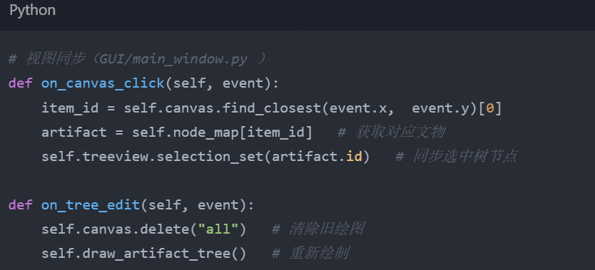
Core GUI interaction
Dual-view synchronization logic
Interactive code
The GUI design achieves dual-view synchronization. Clicking on the Canvas enables selection of TreeView items. After editing the cultural relics, the Canvas is updated in real time. The code logic clearly defines the view synchronization mechanism. Interface screenshots mark the click hot zones, presenting the interactive effect intuitively and enhancing the user experience.
By binding events and callback functions, the synchronization of Canvas clicks and TreeView selections is achieved, as well as the real-time update of the Canvas after the editing of cultural relics, ensuring immediate feedback for user operations and enhancing the smoothness of interaction.

Slide 22
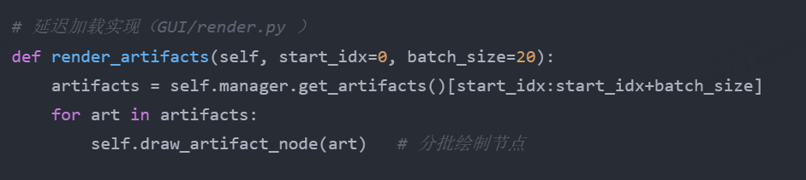
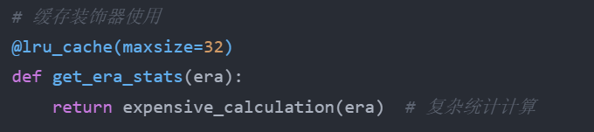
Performance optimization techniques
Introduction to Optimization Methods
Specific implementation code
The system employs three optimization techniques: delayed loading, caching of calculation results, and event debouncing. Delayed loading renders cultural relics in batches, caching of calculation results avoids redundant calculations, and event debouncing reduces invalid operations, significantly enhancing the system performance.
Lazy loading is achieved through batch rendering of the artifacts. The cached calculation results use the LRU cache decorator. Event debouncing reduces invalid triggers through merging operations. The comparison curves of memory/CPU usage before and after optimization visually display the optimization effect.

Slide 23
Additional functions
04

Slide 24
4.1 Interactive Site Map
Interactive Site Map - Details are displayed when the mouse hovers over.
Interactive Site Map - Overview
Provide an intuitive operation interface, enabling users to easily view, edit and delete the information of cultural relics.
Show the detailed information box that pops up when the mouse hovers over the cultural relic node.
Interactive Site Map - Right-click Menu Operations
Interactive Site Map - Click to delete nodes
Demonstrate the operation of deleting by clicking on the cultural relic node.
Show the menu that pops up when you right-click on the cultural relic node.

Slide 25
4.1 Interactive Site Map
Interactive Site Map - Double-click to edit the information of the cultural relics
Interactive Site Map - Search Highlight Function
Demonstrate the operation of double-clicking on the cultural relic node to open the editing dialog box.
Show the effect where the relevant cultural relics nodes are highlighted after entering the search keywords.
Interactive Site Map - Right-click Menu Operations
Show the menu that pops up when you right-click on the cultural relic node.

Slide 26
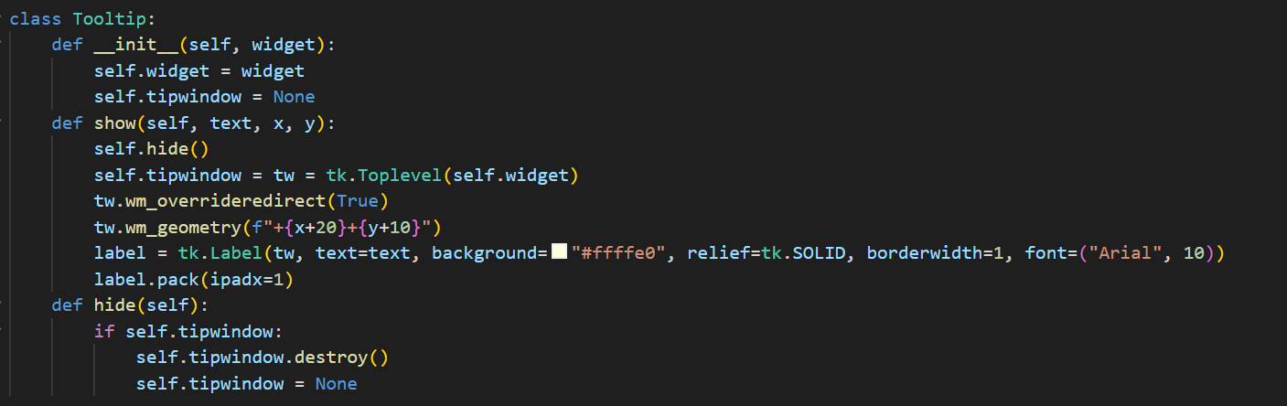
Interactive Site Map - Displays details on mouse hover Through the Tooltip class, a pop-up window is created to display detailed information about the relics when the mouse hovers over them.

Slide 27
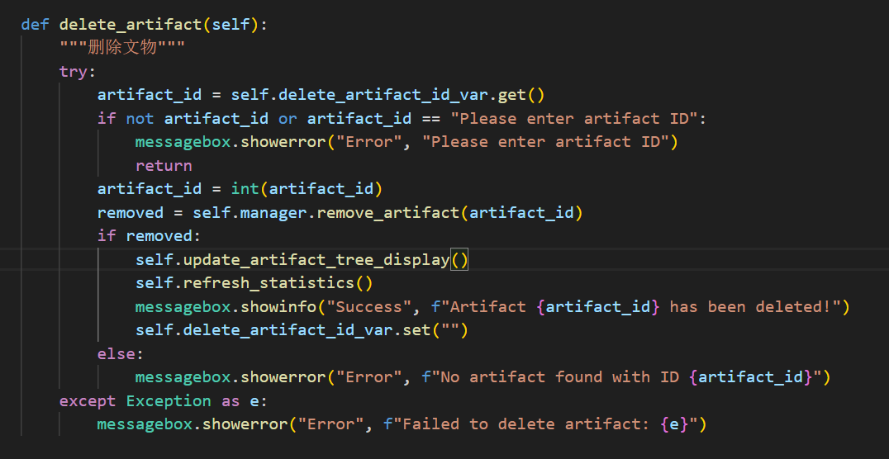
Interactive Site Map - Click to delete nodes. Obtain the artifact ID input by the user, call the remove_artifact method of the manager to delete the artifact, and update the interface and statistical information.

Slide 28
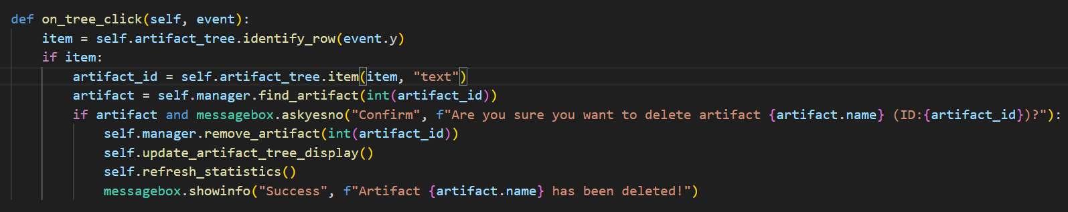
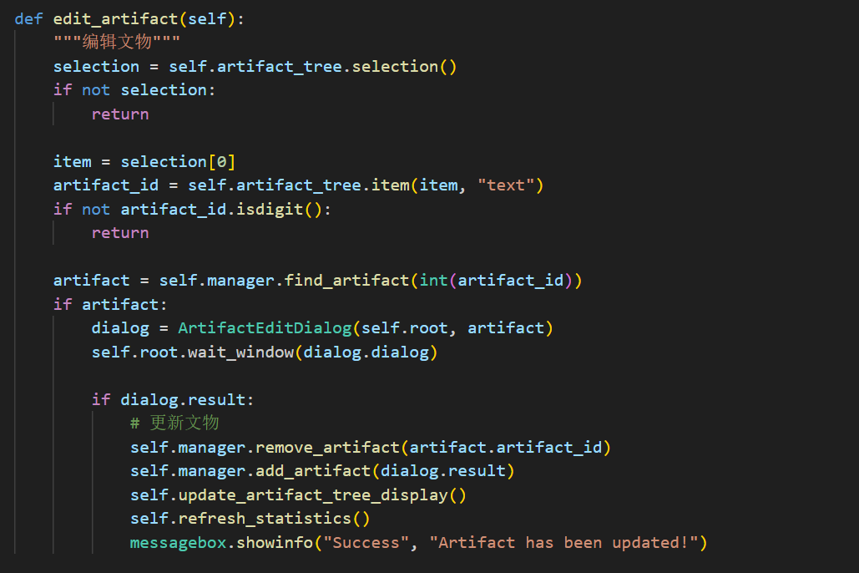
Interactive Site Map - Right-click Menu Operations Create a right-click menu, bind the right-click event, and execute the corresponding operation based on the user's selection.

Slide 29
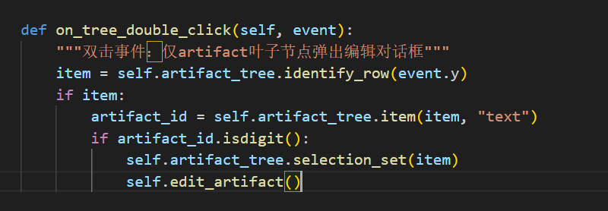
Interactive Site Map - Double-click to edit the artifact information. Bind the double-click event, obtain the ID of the artifact node when it is double-clicked, open the editing dialog box, update the artifact information, and then refresh the interface and statistical information.

Slide 30
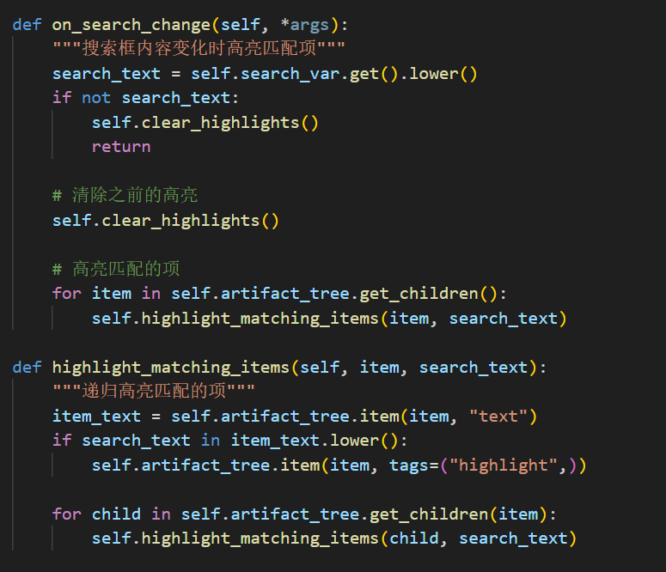
Interactive Site Map - Search Highlight Function Monitor changes in the search box input and highlight the matching cultural relics nodes based on the keywords.

Slide 31
4.2 Analysis of Cultural Heritage Protection
Cultural Heritage Protection Analysis - Real-time Statistical Updates
Cultural Heritage Protection Analysis - Analysis of Distribution by Era or Type
Demonstrate the effect of real-time updates of statistics and charts after adding or removing cultural relics.
Show the detailed information box that pops up when the mouse hovers over the cultural relic node.
Cultural Heritage Protection Analysis - Identification of Protection Needs
Cultural Heritage Protection Analysis - Data Visualization Charts
Based on the data of time and type distribution, identify the less numerous parts and propose protection suggestions.
Display the pie chart showing the distribution of cultural relics over different periods and the bar chart showing the distribution of types.

Slide 32
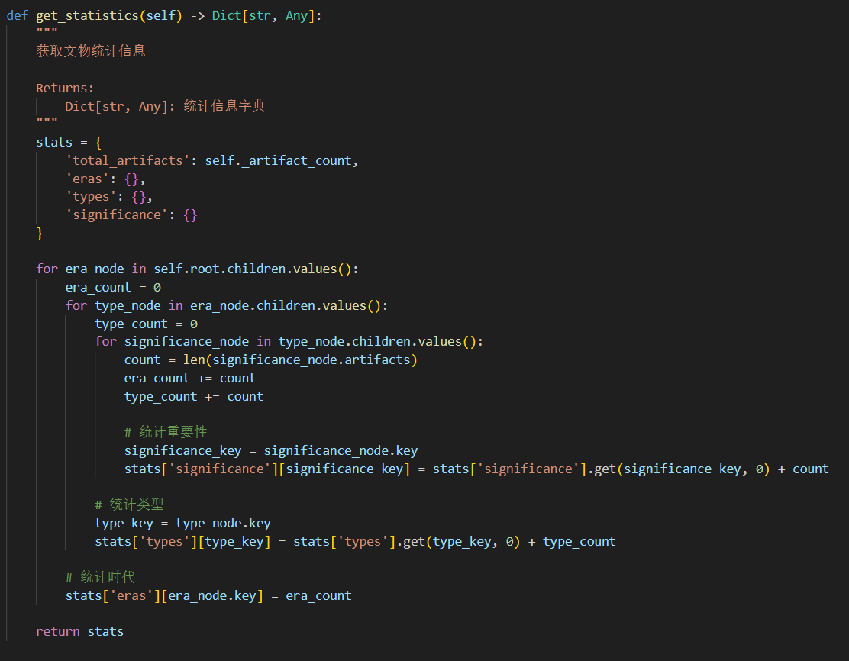
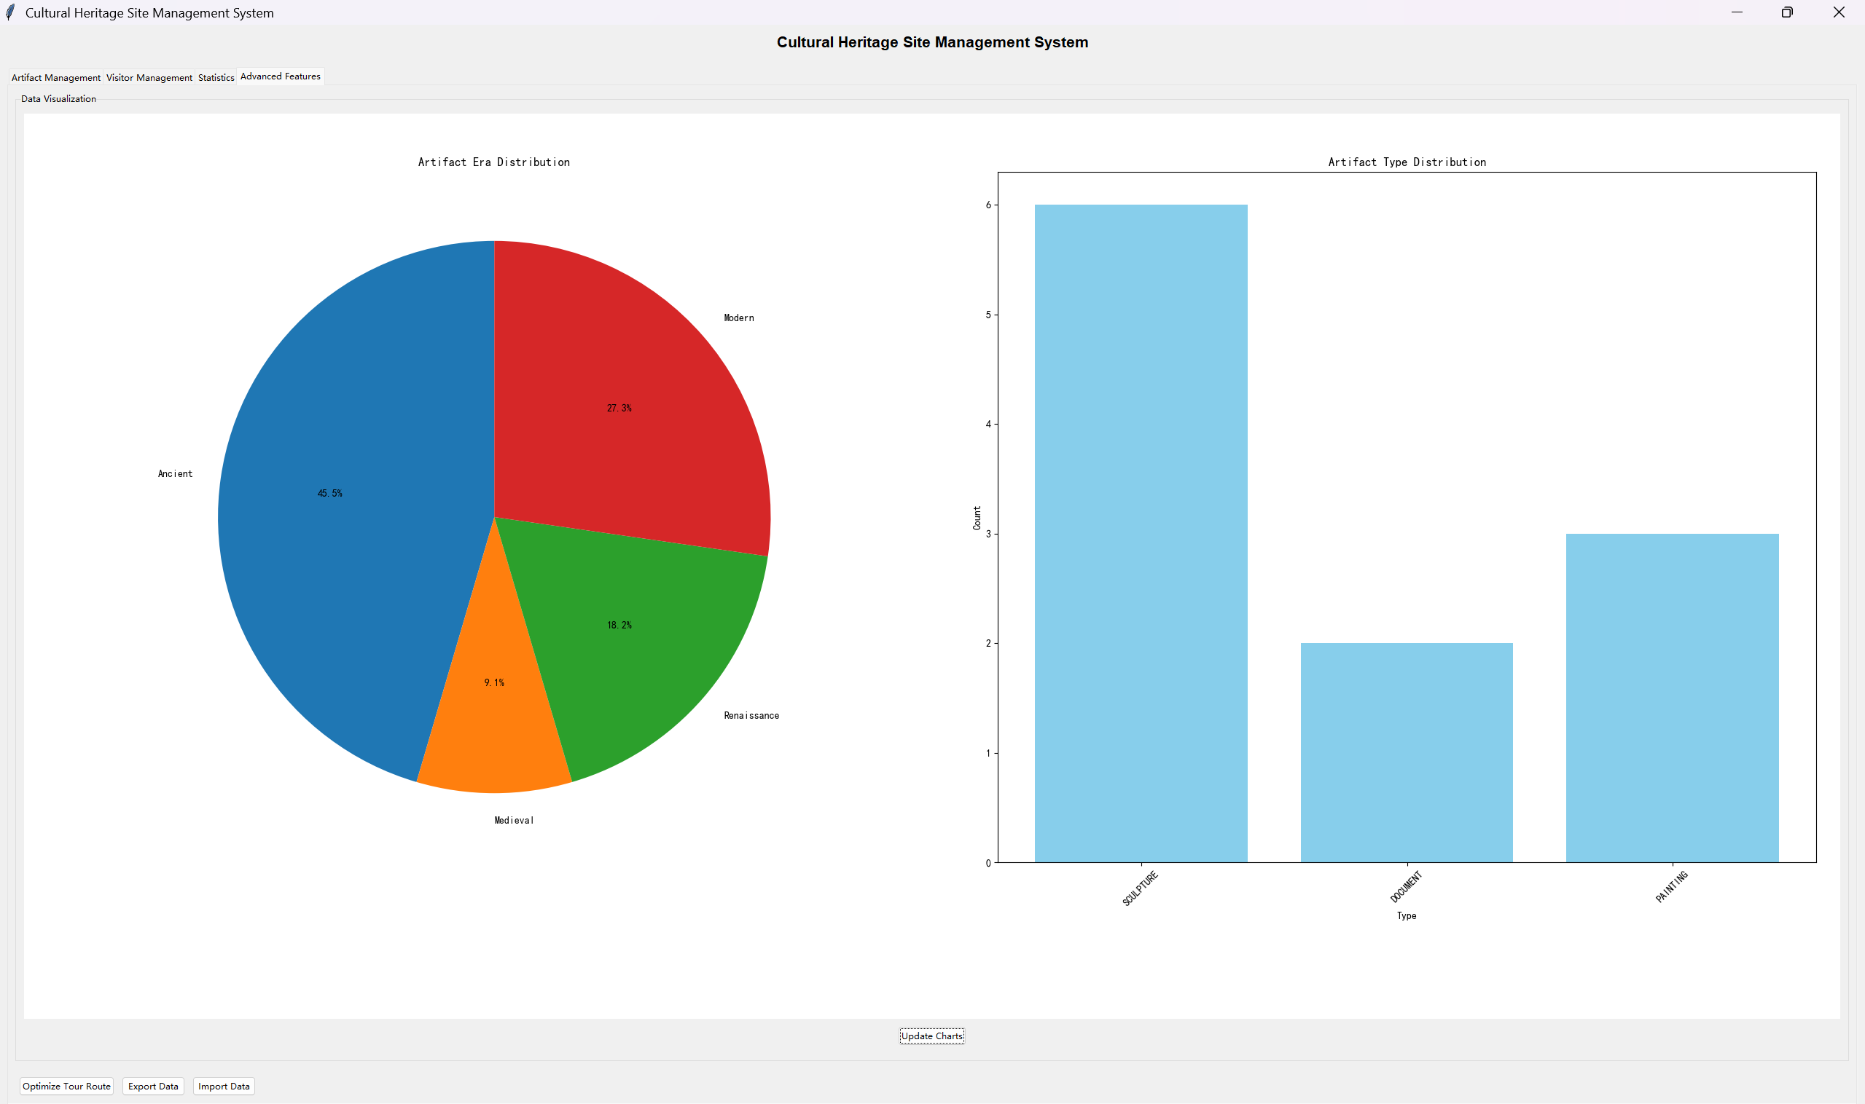
Cultural Heritage Protection Analysis - Time or Type Distribution Analysis Traverse the cultural heritage tree and count the distribution of cultural relics by era, type, and importance.

Slide 33
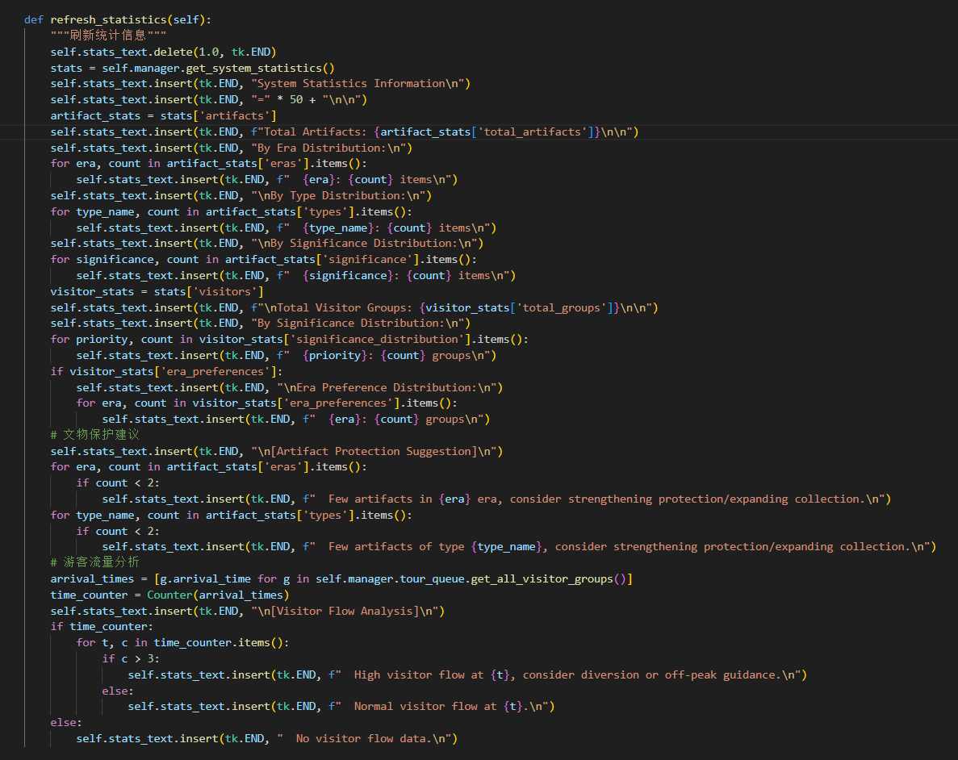
Cultural Heritage Protection Analysis - Identification of Protection Needs Based on statistical data, identify the less numerous eras and types, and provide protection suggestions.

Slide 34
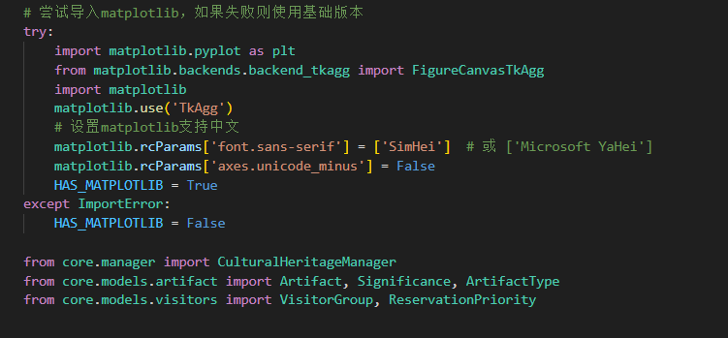
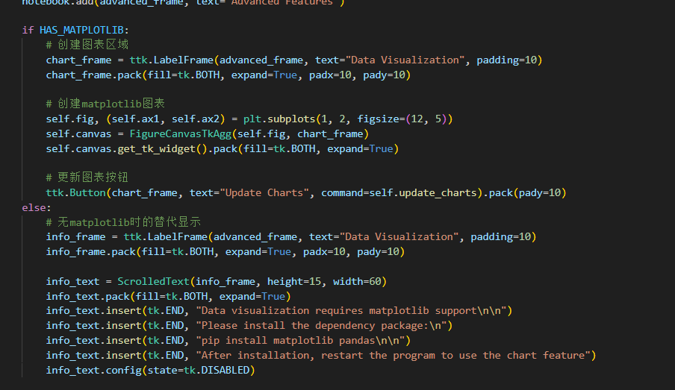
Cultural Heritage Protection Analysis - Data Visualization Charts Using the matplotlib library, pie charts and bar charts are drawn to display the distribution of cultural heritage eras and types.

Slide 35
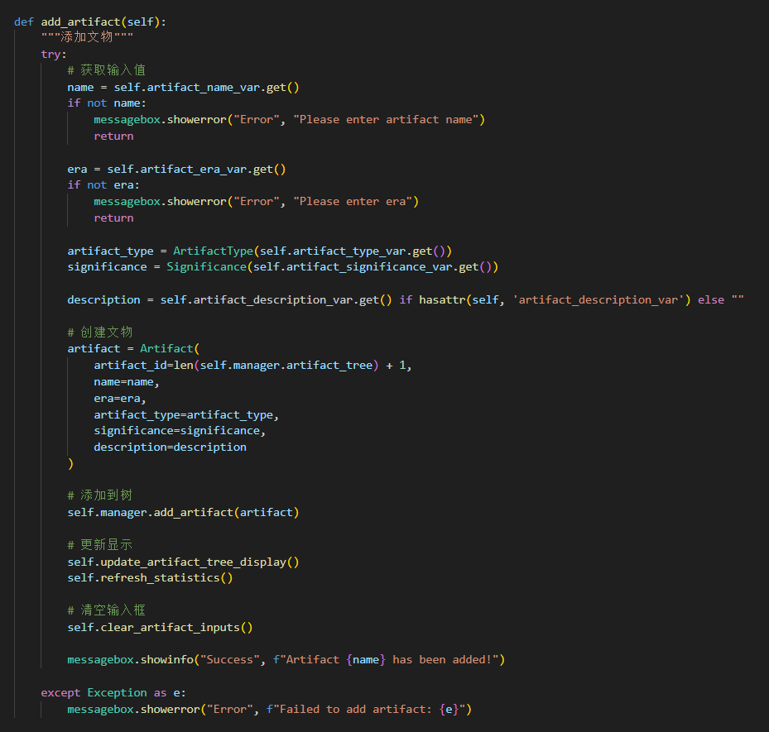
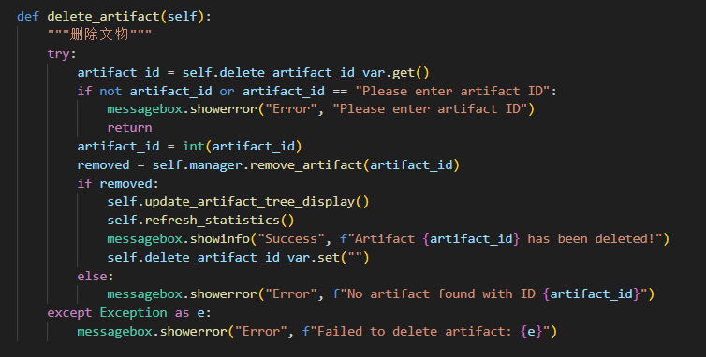
Cultural Heritage Protection Analysis - Real-time Statistical Updates During the operations of adding or deleting cultural relics, the refresh_statistics method is called to update the statistical information and charts.

Slide 36
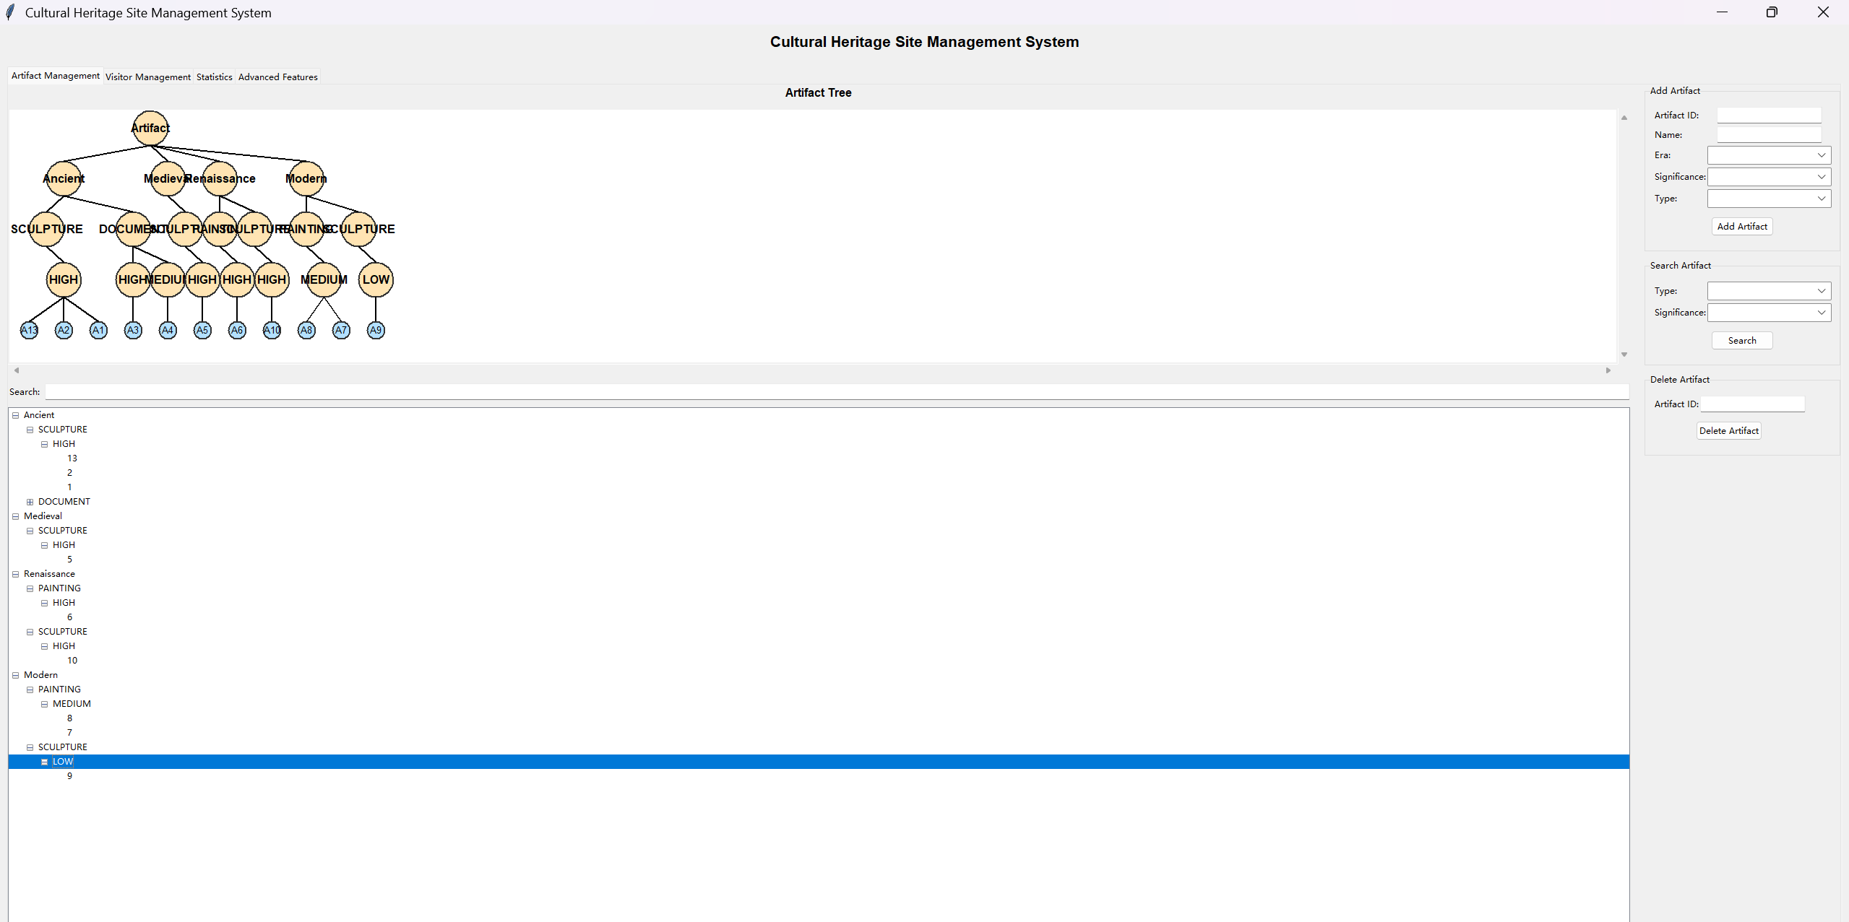
Running result

Slide 37
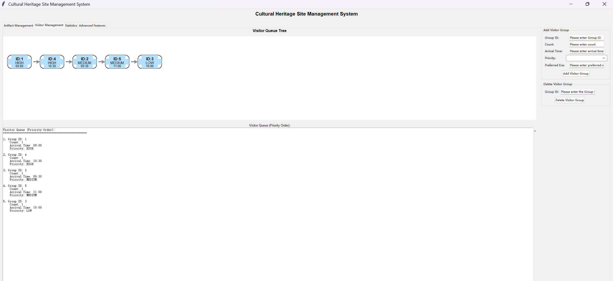
Running result

Slide 38
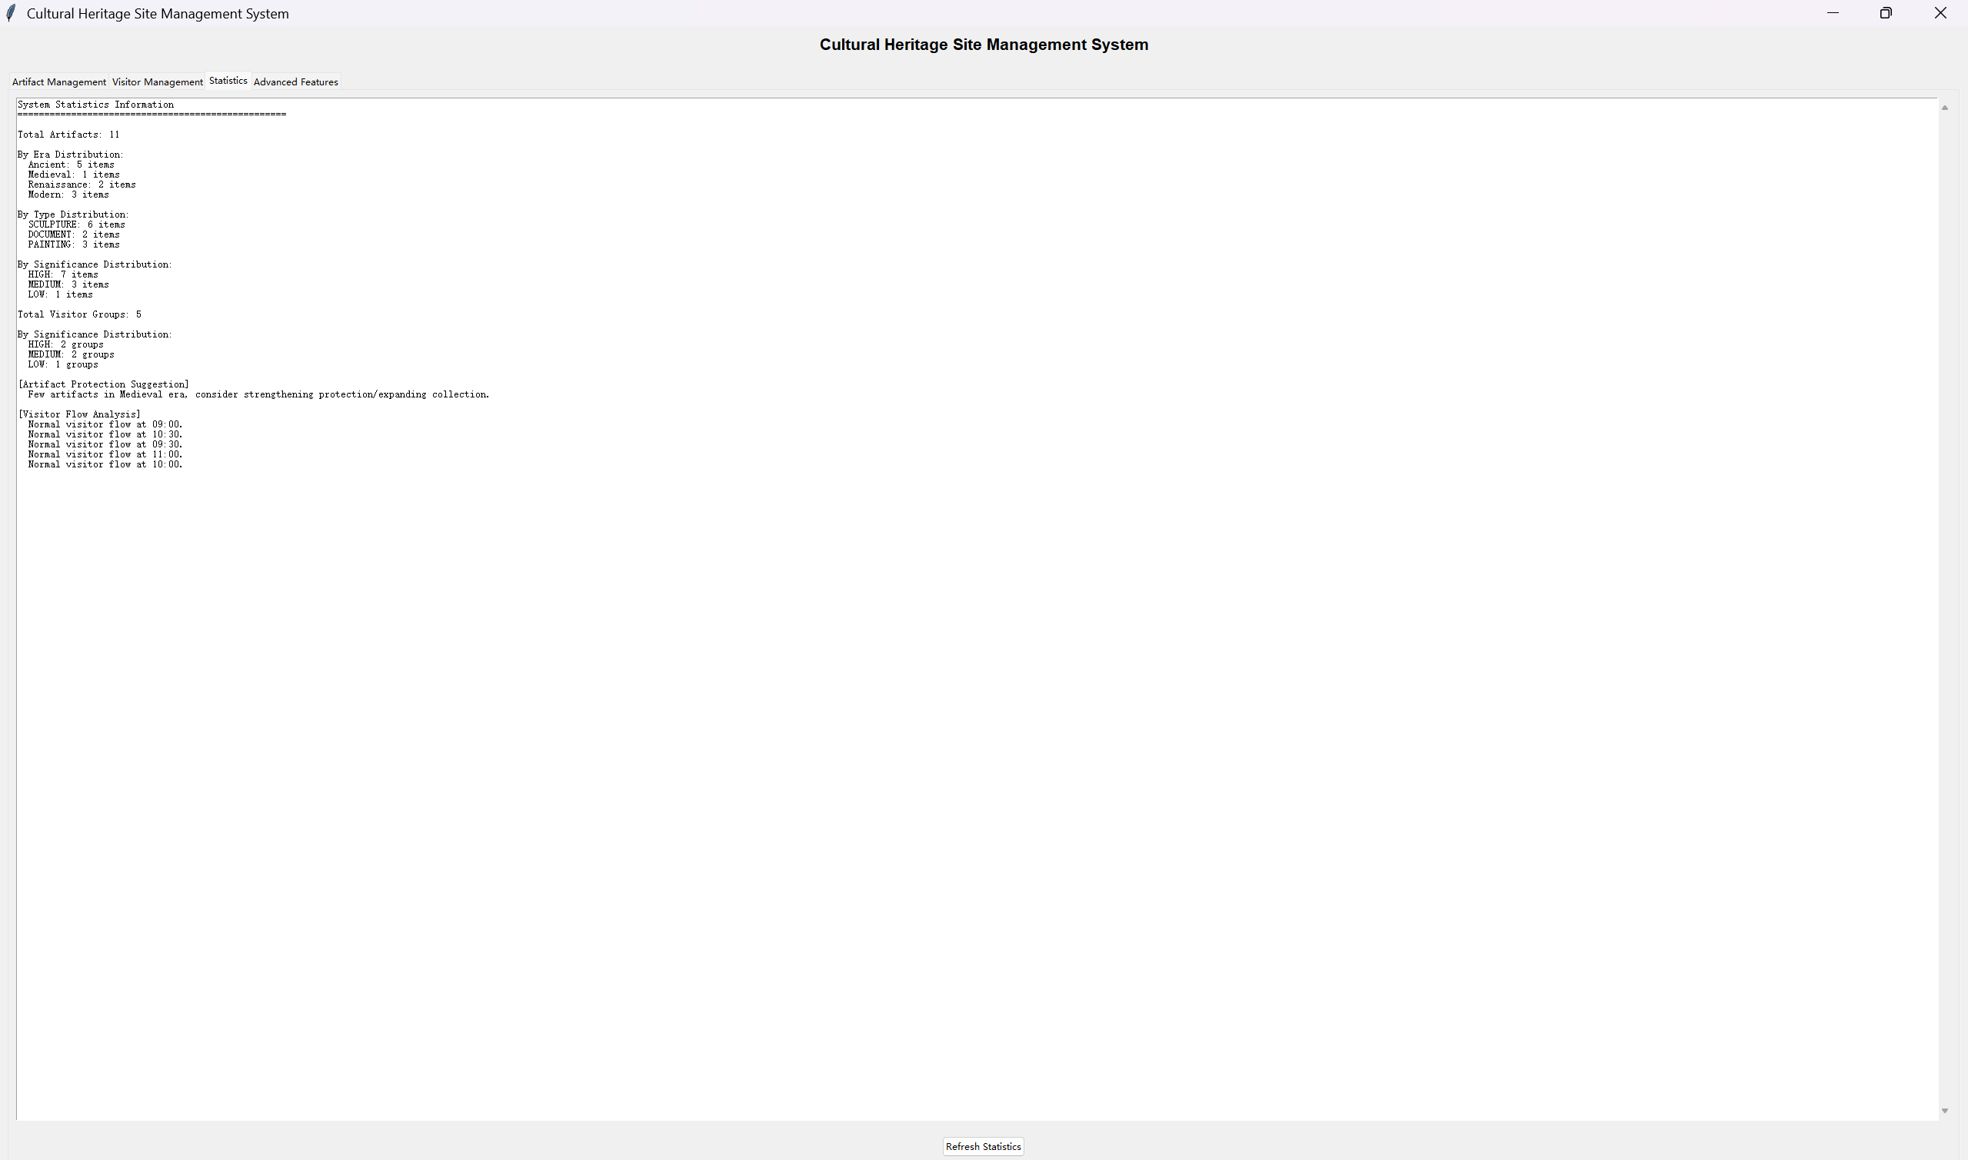
Running result

Slide 39
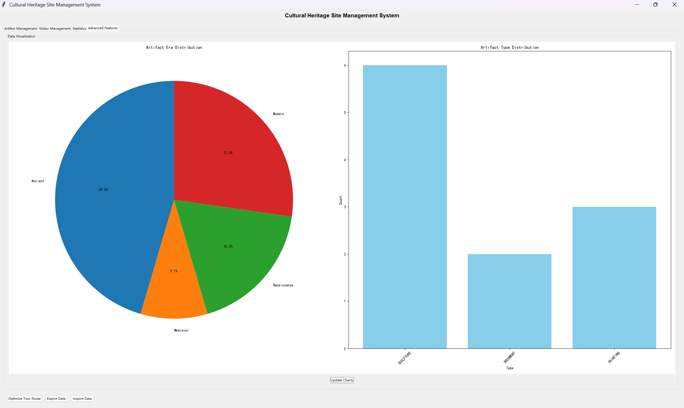
Running result

Slide 40
5. Summary and Group Assignment
Participating in the Python development of the cultural heritage management system, I mastered the implementation logic of tree structure recursive construction, GUI event binding and real-time data linkage, and learned to break down complex functions using modular thinking. From code debugging to interface interaction optimization, the teacher's patient guidance helped me break through technical barriers and turn scattered code into a complete system. This practice deepened my programming skills and I am more grateful for your professional guidance!
XinGang JiaKe - Code Design and Interface Development
KeRan ZhiBO JiaKe XinGang - Presenting Reports
XinGang JiaKe KeRan ZhiBO Zhenghao Yao- PPT Production

Slide 41
Thanks

